Slide 1
Group 5
Tutoring Service Database
Mark Baker, Sasha Campbell, Tyler Crenshaw, Kelly Gest, Megan Gest, Narottam Jajodia, Olabisi Osibogun, and Sherilyn Selvakumar

Slide 2
Business Model
Online tutoring service provides graduate business students at the University of Florida with electronic study packets made by tutors.
Customers can subscribe by creating a free account to view all available study packets.
There is only one annual subscription level.
Our entities include: Customer, Employee, Course, Subscription, Study Packet, Credit Card, and Professor.

Slide 3
Assumptions
An Employee cannot be a Customer
Multiple Professors can teach the same Course
One or many Credit Cards can be filed for one Customer
One or many Customers subscribes to one or many Study Packets
Each Professor can be associated with one to many Study Packets
Each Study Packet can be assigned to one or many Employees
An Employee is assigned to only one Study Packet
A Professor can only teach one Course

Slide 4
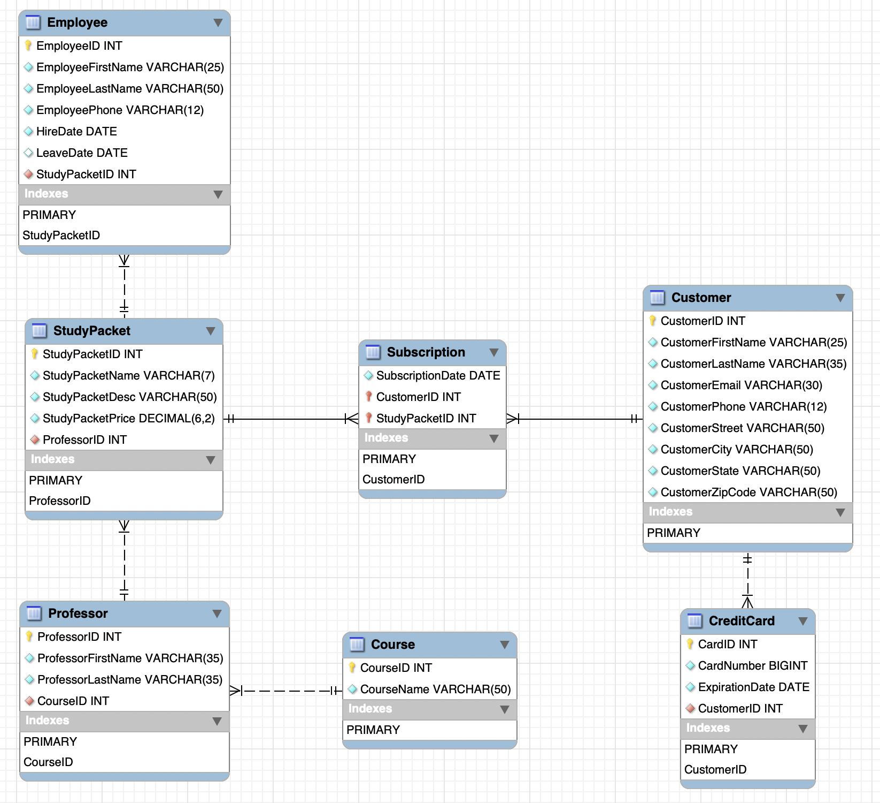
ER Diagram

Slide 5
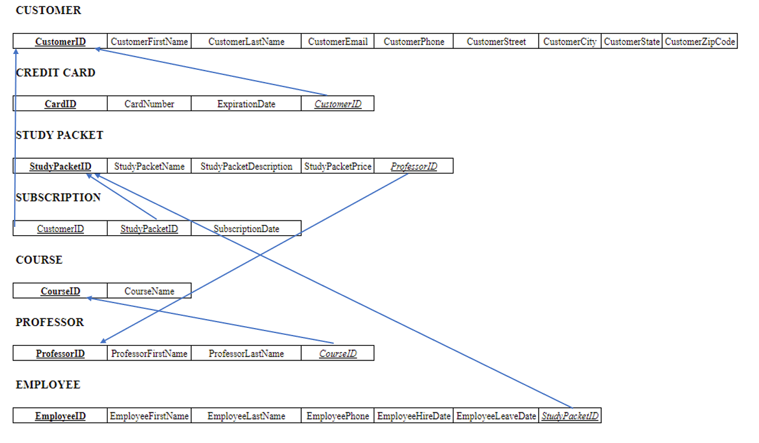
Normalized Logical Schema (3 NF)

Slide 6
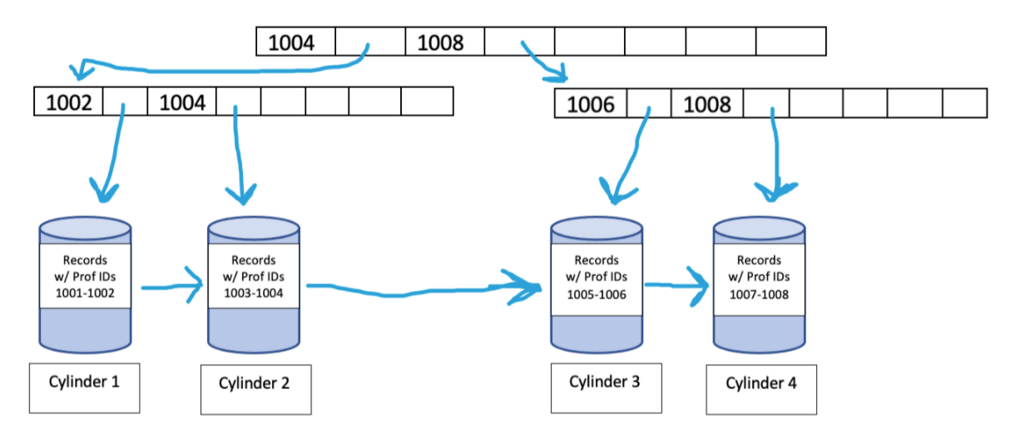
Physical Storage: B+ Tree Index

Slide 7
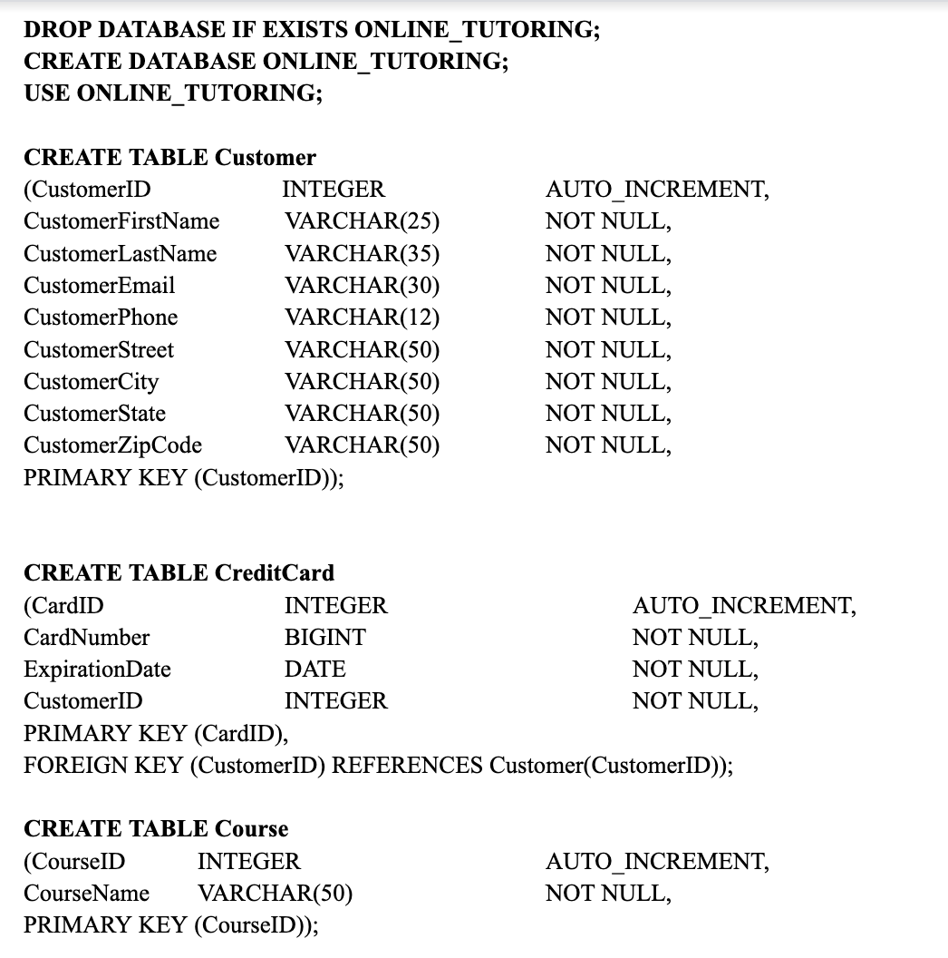
Database Creation

Slide 8
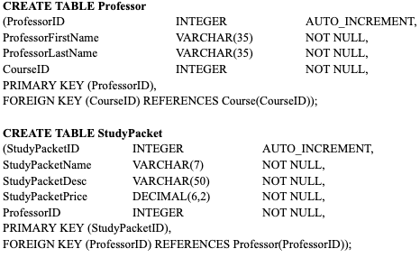
Database Creation

Slide 9
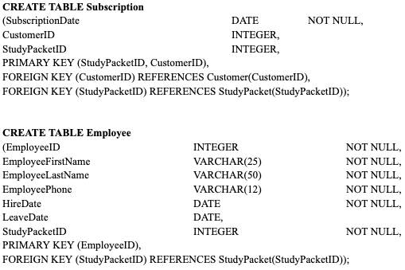
Database Creation

Slide 10
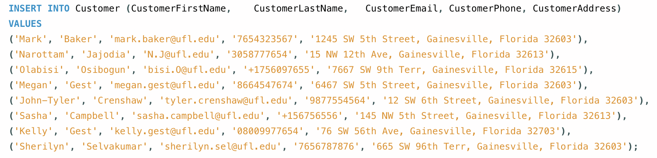
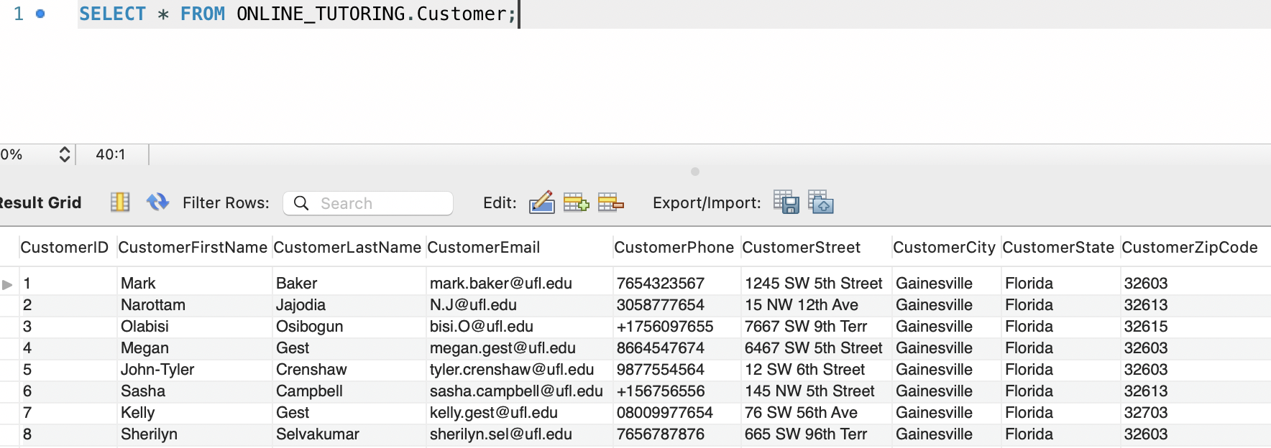
Database Insertion: Customer Table

Slide 11
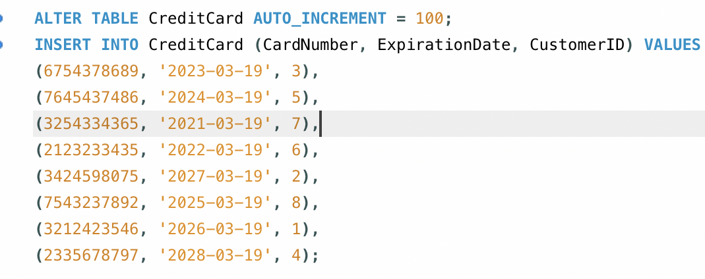
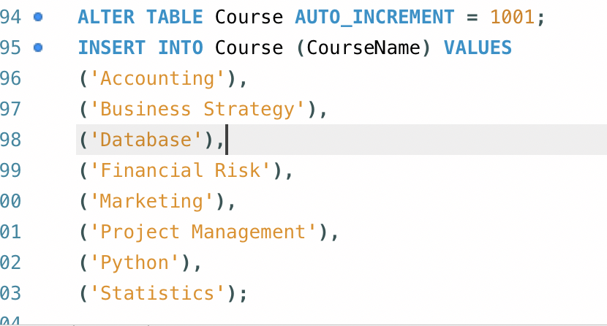
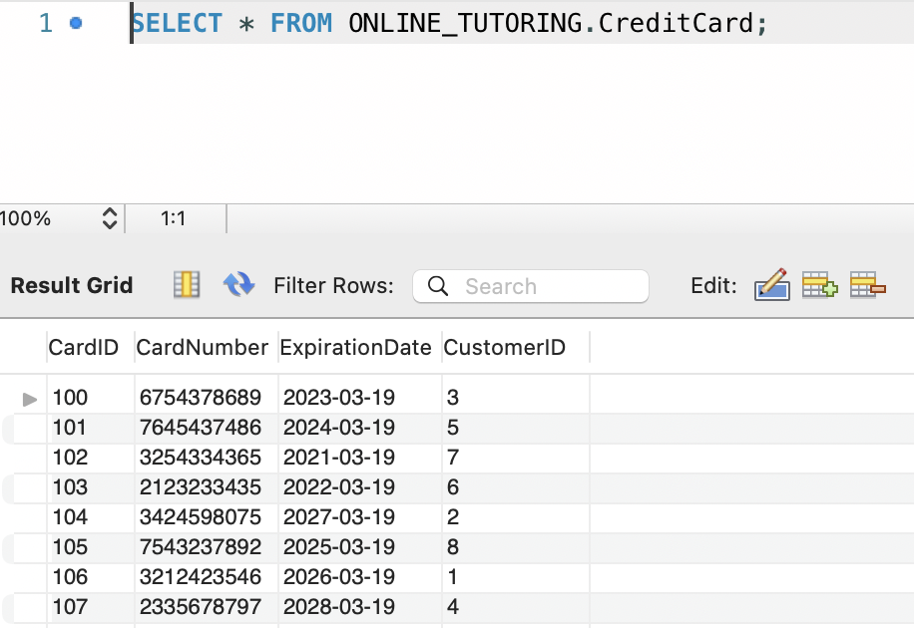
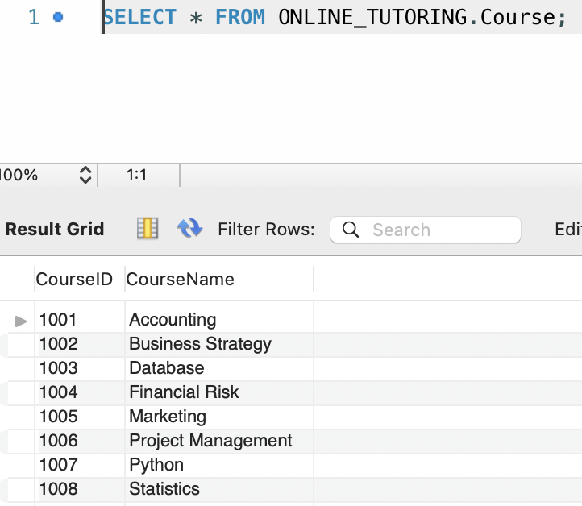
Database Insertion: Credit Card & Course

Slide 12
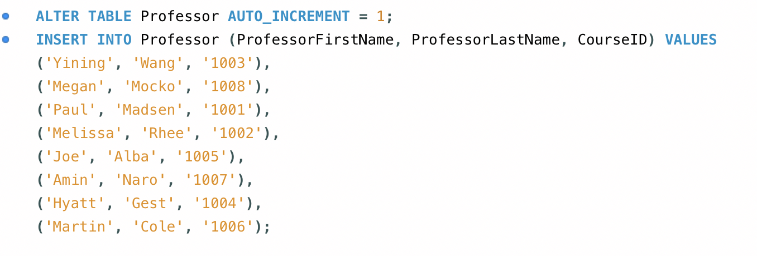
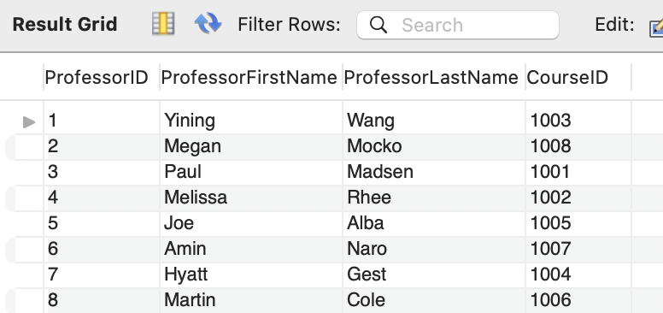
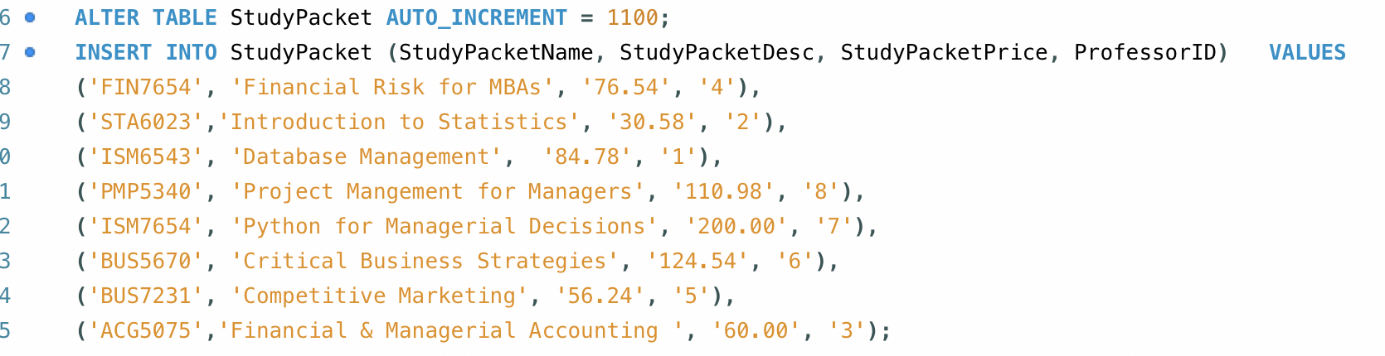
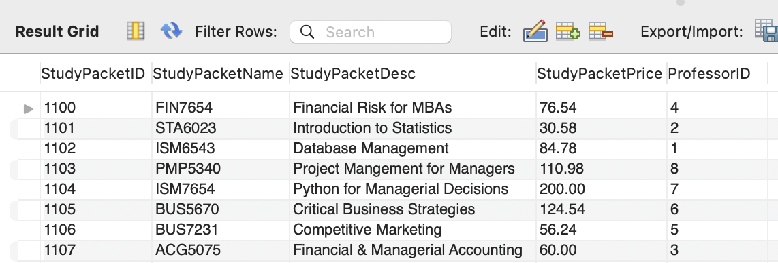
Database Insertion: Professor & StudyPacket

Slide 13
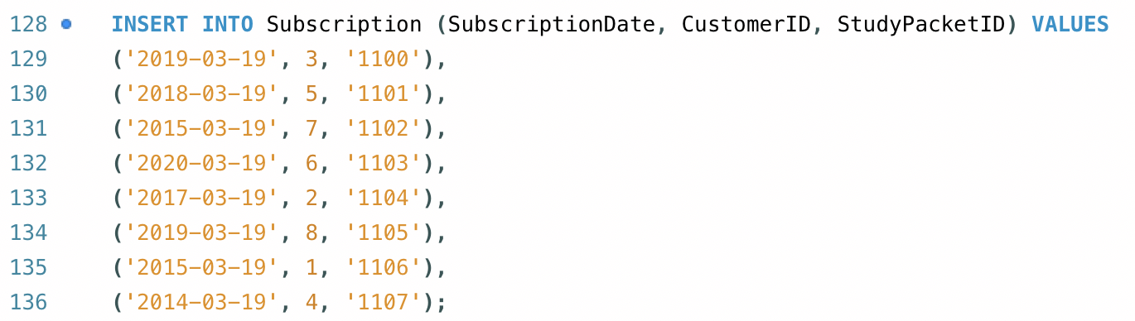
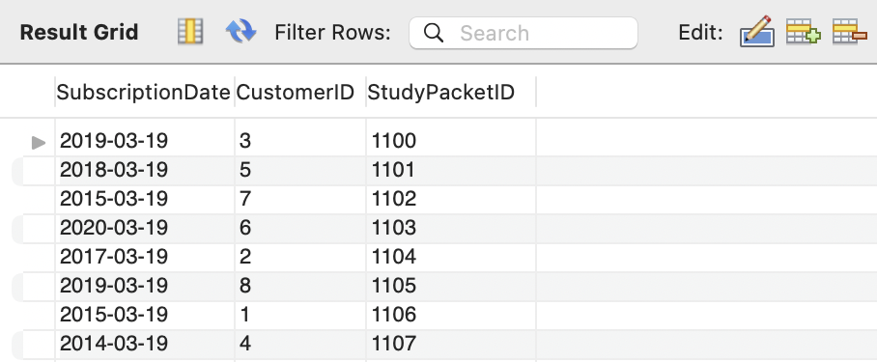
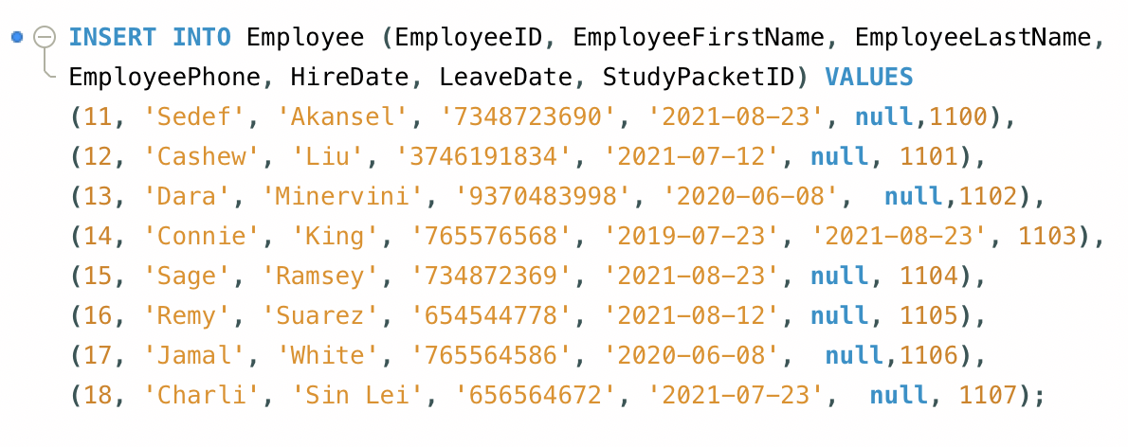
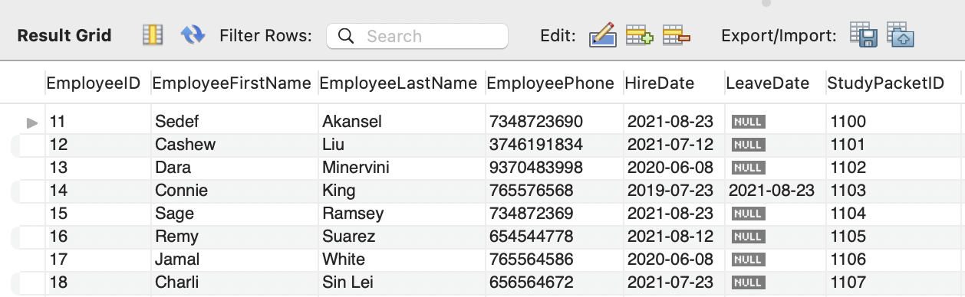
Database Insertion: Subscription & Employee

Slide 14
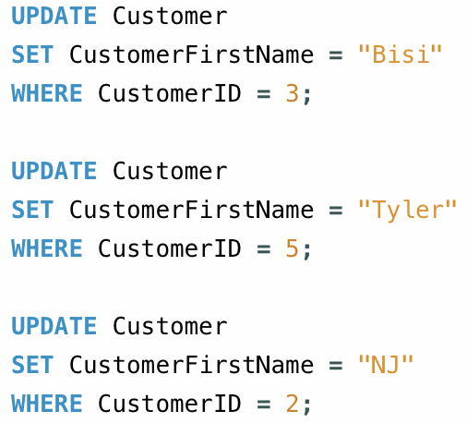
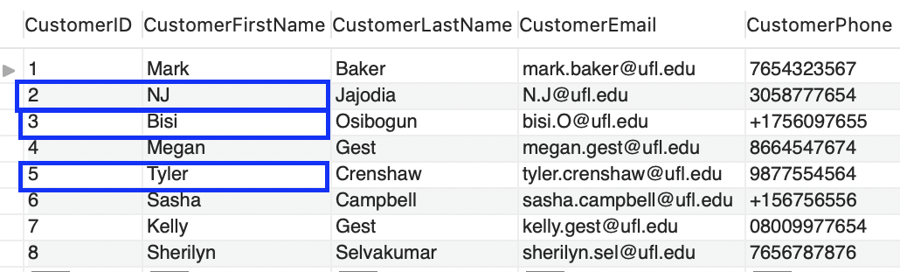
Database Modification
Updating Customer First Name
Original Table
Modified Table

Slide 15
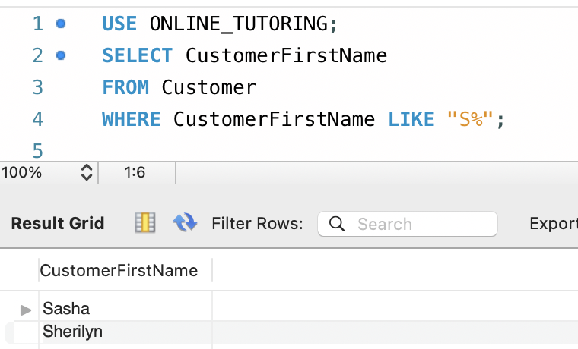
Database Queries
Extracting First Names that start with S

Slide 16
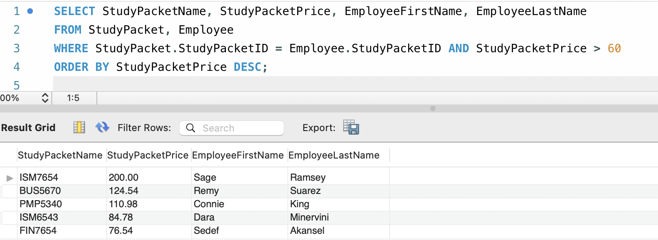
Database Queries
Joining Tables

Slide 17
Questions?

Slide 18
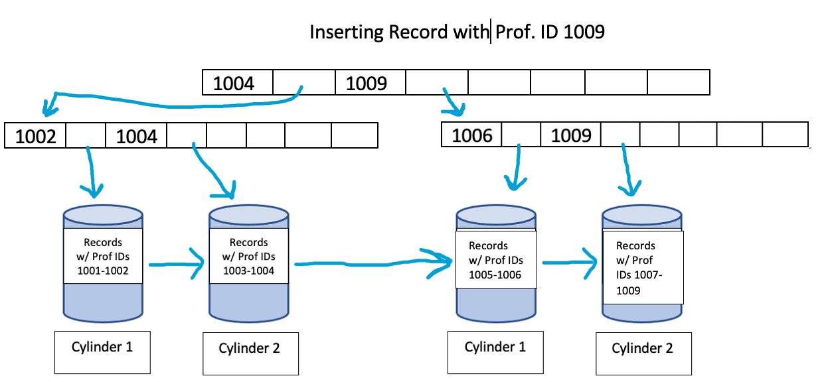
Example of Inserting a New Record

